Slide 1
Week 2 Workshop
Web Development Fundamentals
HTML, CSS, and JavaScript

Slide 2

Agenda
Activity​​ | Time​​ | ~Start
Get Prepared: Log in to Nucamp Learning Portal • Slack • Screenshare​​ | 10 minutes​​ | 9:00am
Check-In​​ | 10 minutes​​ | 9:10am
Week 2 Review | 40 minutes​​ | 9:20am
Task 1​ | 60 minutes​​ | 10:00am
BREAK​​ | 15 minutes​​ | 11:00am
Tasks 2 & 3 | 90 minutes​​ | 11:15am
Check-Out​​ | 15 minutes​​ | 12:45pm

Slide 3
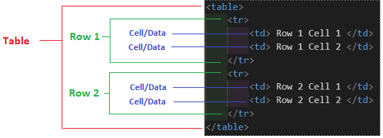

HTML Tables
Use to display tabular data - not for page layout
Can use <thead> and <tbody> as containers (sections) for table header and body rows
Can use <th> to create header cells with bold, centered text content
Note: The example below includes a border applied using CSS, default style does not include a border

Slide 4
HTML Forms
Use action attribute in the <form> start tag to provide a URL for a server-side script to process the form
Set method attribute to "post" or "get"
GET: Request data
POST: Send data

Slide 5



Form Submission
Transfer Form Data to Web server
Web Server Processes Data
Transfer Web Server Response to Client
Client Browser displays response
Client Browser Submits Form
Web Server Sends Response back

Slide 6
HTML Forms – Input Element
Using the input element with the type attribute
Form Input Element "Types" | Description
type="text" | single-line text input
type="submit" | submit button, runs the script given in form action attribute
type="file" | file chooser, allows selecting file from local filesystem to upload - must add enctype="multipart/form-data" to <form> start tag
type="radio" | create radio button, use in a group of 2 or more
type="checkbox" | create checkbox, can be single or multiple
… and more! https://www.w3schools.com/html/html_form_input_types.asp
type="email" - Check if in email format
type="month" - Provides a calendar select
type="color" - Provides a Color Palette selector

Slide 7
HTML Forms – More Form Elements
<fieldset> - use to group similar form controls together
<legend> - use to caption a fieldset
<textarea> - use to create a multi-line text input
<option> and <select> - use to create dropdown lists
Give all form controls (elements which can have their value changed by the user) a name attribute.
Only form elements with a name attribute will have their values passed when submitting a form

Slide 8

HTML Forms - <label> element
Form labels are helpful for accessibility in two ways:
Used by screen readers
Creates a larger target area for mouse clicks or touchscreen finger presses
The label's for attribute value must match the id attribute of the form element it's paired with:
Example:

Slide 9

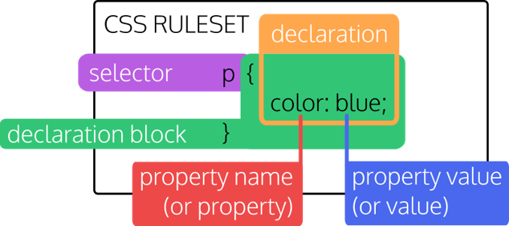
CSS Syntax
Syntax:

Slide 10

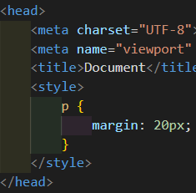
Adding CSS Three Ways
Inline Style
Add directly to an element with the style attribute
Internal Stylesheet
Add to the <head> of an HTML document using <style> element with CSS rulesets inside it:
External Stylesheet
Add reference in the <head> of an HTML document by using void <link> element with rel attribute set to "stylesheet" and href attribute pointing to an external .css file with CSS rulesets inside it

Slide 11
Element Selector
Also known as type selector
The element selector p { … }
Will select all elements of that name (paragraph elements) in the HTML document <p>

Slide 12


Class Selector
In a CSS ruleset, use . in front of the class name
For the class name: Use hyphens for multiple words (no spaces), don't start with a number, use lower case
Apply this ruleset on a HTML element using class attribute. You can set multiple classes on one element by separating with spaces. Order does not matter
Can set the same class on multiple elements, ex.:

Slide 13

ID Selector
In a CSS ruleset, use # in front of the id name
For the ID name: Use hyphens for multiple words (no spaces), don't start with a number, use lower case
Only set one ID per element
Apply this ruleset on a HTML element using id attribute. Only use each ID once per document, do not use it on more than one element
Generally, avoid using IDs as a selector if you can use a class instead

Slide 14
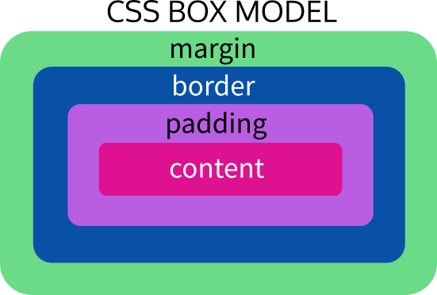
CSS Box Model
Element content, padding, border, margin
Element's width/height does not include the length of the padding, border, and margin – so be careful or your element will take up more room than you expect!

Slide 15
Shorthand Properties & Margin
Many CSS properties (but not all) come in sets that can be combined together into a shorthand property
Example: The margin shorthand property is a shorthand for the margin-top, margin-right, margin-bottom, and margin-left properties
You can set each separately, e.g.:
margin-top: 5px;
margin-right: 10px;
margin-bottom: 15px;
margin-left: 20px;
Or you can set them all at once with the margin shorthand (margin: top, right, bottom, left)
margin: 5px 10px 15px 20px;
Convenient - but sometimes you may only want to set one side!

Slide 16
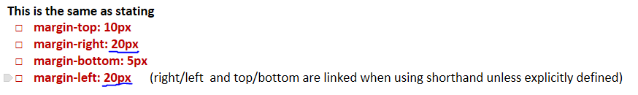
Margin & Padding
margin is the space outside of an element's border, padding is the space inside it
margin and padding shorthand properties set lengths in clockwise direction
Example: margin: 5px 10px 15px 20px; will apply 5px to top margin, 10px to right margin, 15px to bottom margin, 20px to left margin – padding works the same way
If you provide 2 values to the margin or padding shorthand, the first will be applied to the top & bottom, the second will be applied to the right & left
Example: padding: 5px 10px; will apply 5px to top and bottom padding, 10px to left and right
If you provide 1 value to the margin or padding shorthand, it will be applied to all sides
Discuss: The challenge question on the margin shorthand with three values -- What was your answer?

Slide 17
Border Property
The border shorthand property includes these border properties:
border-width
border-style
border-color
You must include the border style (solid, dotted, double, etc) to set the border; otherwise it will default to none and the border will not be visible

Slide 18
Font Property
The font shorthand property includes these font properties:
font-size
font-style
font-weight
font-family
and others
When using the font shorthand property, font-family and font-size are required, and font-family must come last in order

Slide 19
Background Property
The background shorthand property includes all CSS background- properties:
background-color
background-image
background-repeat
background-size
Many others
To only set the background color, use: background: red;
This will have the same result as writing: background-color: red;

Slide 20
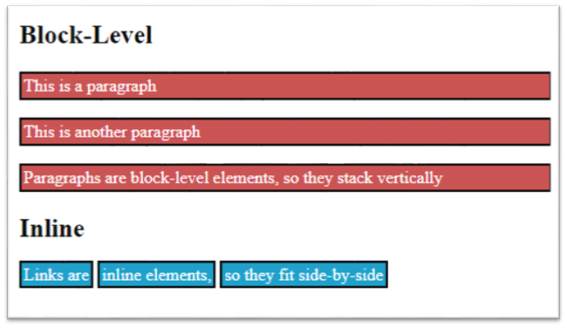
Display Property
Some common values for the display property:
Block: will begin on a new line and take up the full width of the line, can set width & height properties on element with display: block;
Inline: will stay on the same line; cannot set width/height properties on element with display: inline;
Inline-block: will stay on the same line, but CAN set width & height properties as if it were a block element
Invalid – Can't set width/height
span { display: inline; width: 500px; height: 50%; }

Slide 21
CSS Color Values & Color Property
Ways to encode color values in CSS:
Color names – blue, green, violet, etc
Hex color codes - #ffffff, #fa8072, etc
Other ways include RGBA, HSL, more...
The color property in CSS is used mainly to set text color

Slide 22
CSS Specificity
An HTML file can have CSS from many different sources:
Inline styles
Internal stylesheet
External stylesheet
User-agent stylesheet (browser defaults)
User stylesheet (custom stylesheet set by user in their browser)
The cascading algorithm of CSS figures out how to determine which rules to apply

Slide 23
CSS Specificity (continued)
Inline styles have highest specificity and will override styles set in stylesheets
Stylesheet CSS rules are applied in order of appearance, whether internal or external
When multiple rules target the exact same selector and property, the last one is used since it will overwrite all the previous rules
If multiple, different selectors target the same element, then the order does not matter, instead, rules of specificity are used to figure out which one takes precedence

Slide 24
CSS Specificity and Selectors
Point value system to determine which selectors have higher specificity:
Inline styles: 1000
ID: 100
Class, attribute selector, pseudo-class: 10
Element/type: 1
Discuss: How many points is this selector? .my-class + div:hover
21 points : .my-class is 10 points, :hover is 10 points, div is 1 point

Slide 25
CSS Specificity and Selectors
!important
The value !important can be added to a CSS declaration to give it highest precedence, even over inline styles – this is not so much a selector as a last resort trick that should be used carefully and sparingly
min-width: 100% !important;

Slide 26


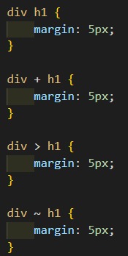

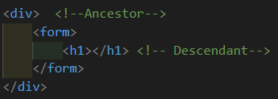

Some More Advanced Selectors
Grouping selectors/selector list (h1, div, .my-class)
Pseudo-classes (a:hover)
Attribute selectors (input[type="text"])
Combinators
Descendant selector (div h1) Direct Child selector (div > h1)
Adjacent sibling selector (div + h1) General sibling selector (div ~ h1)
https://www.w3schools.com/cssref/css_selectors.asp

Slide 27
Workshop Assignment
It's time to start the workshop assignment!
Break out into groups of 2-3.
For online Workshops your instructor may break you out into diffent virtual rooms
Work closely with each other.
Don't forget that the 20-minute rule becomes the 10-minute rule during workshops!
10-minute rule does not apply to talking to your partner(s). Work together throughout. This will be useful practice for working with teams in real life.
Follow the workshop instructions very closely.
Talk to your instructor if any of the instructions are unclear to you.

Slide 28
Assignment Submission & Check-Out
Submit the datingform.html page at the bottom of the assignment page in the learning portal.
Example instruction on the next slide

Slide 29

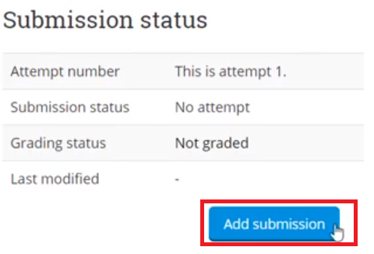
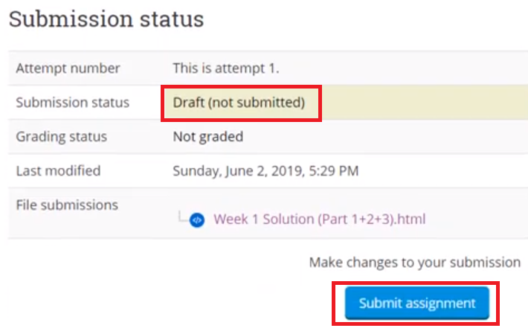
Submitting Your Assignment
Go to https://learn.nucamp.co
Click "Workshop Assignment: Students' Work"
Upload your work by clicking "Add Submission", select the file, and then click "save"
Note that your work is in Draft status
Click "Submit assignment" to submit it

Slide 30
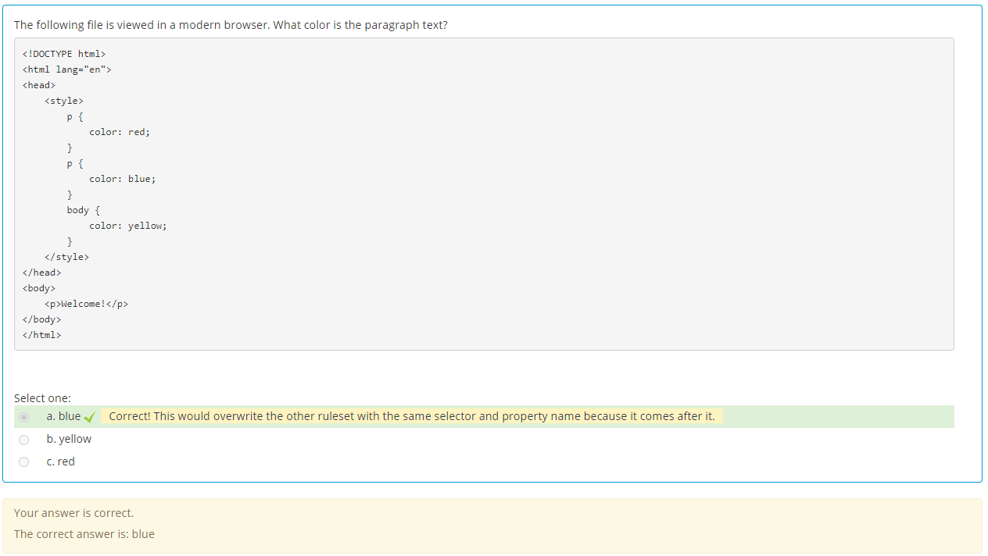
Review: Week 2 Quiz

Slide 31
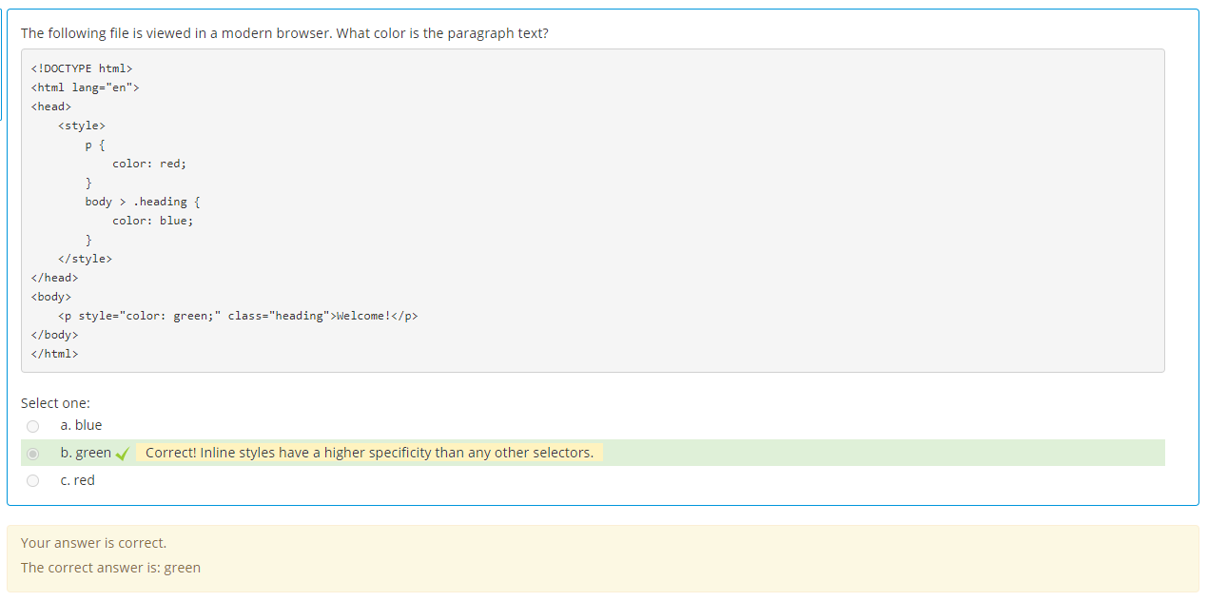
Review: Week 2 Quiz

Slide 32
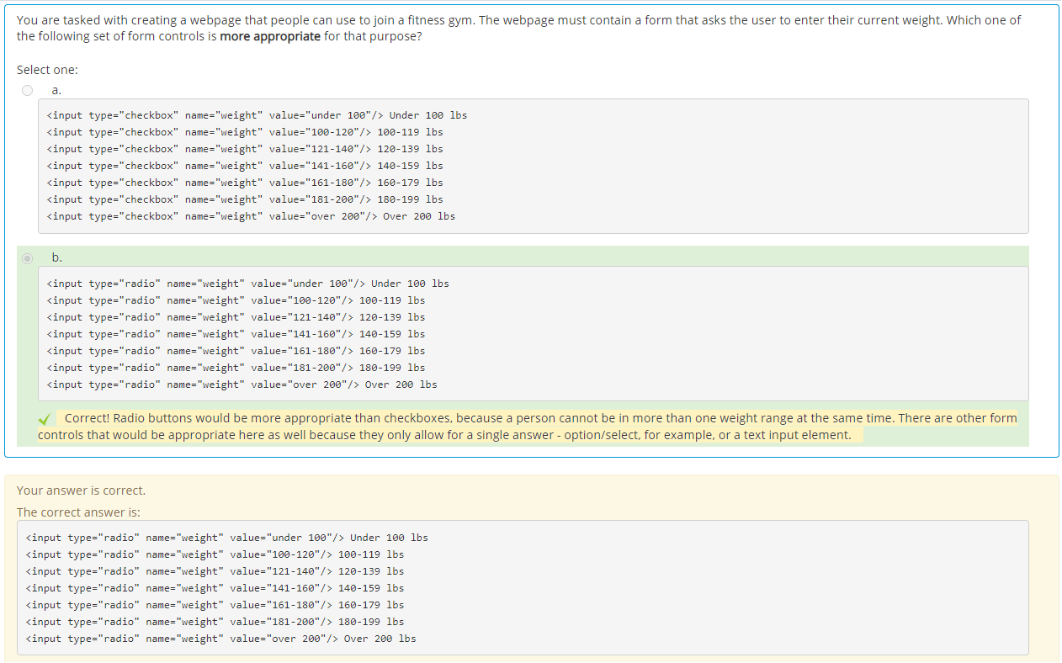
Review: Week 2 Quiz

Slide 33
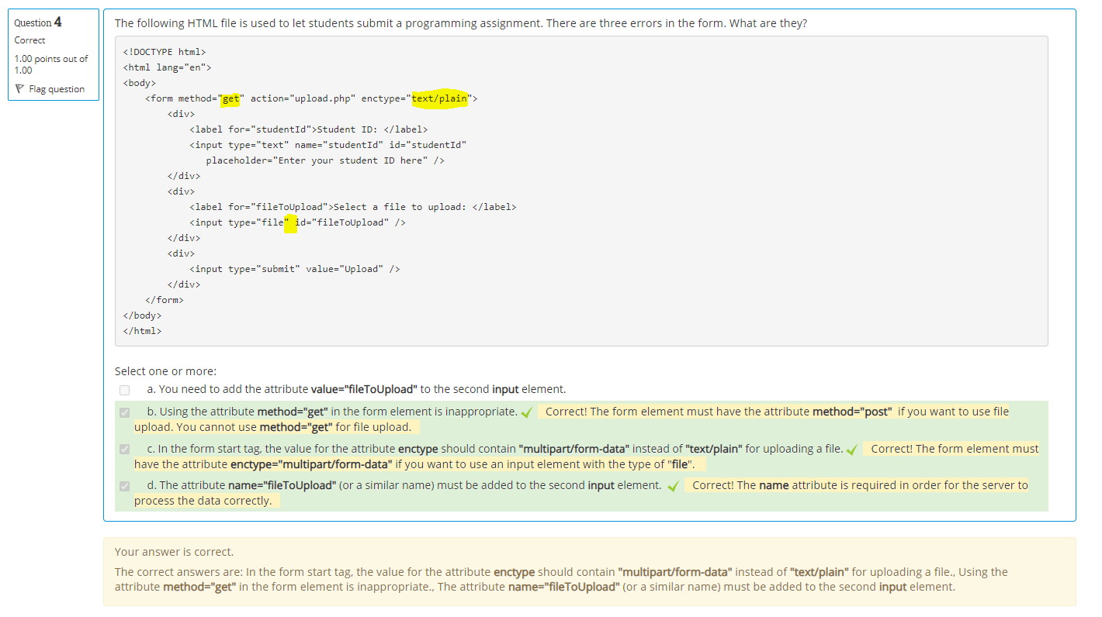
Review: Week 2 Quiz

Slide 34
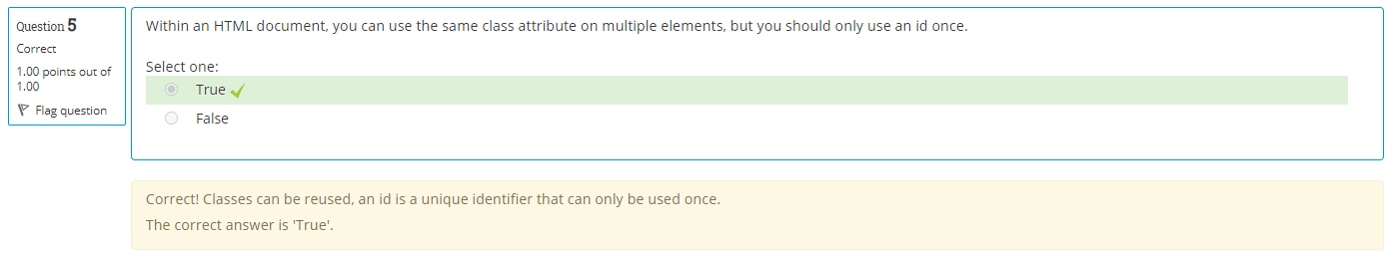
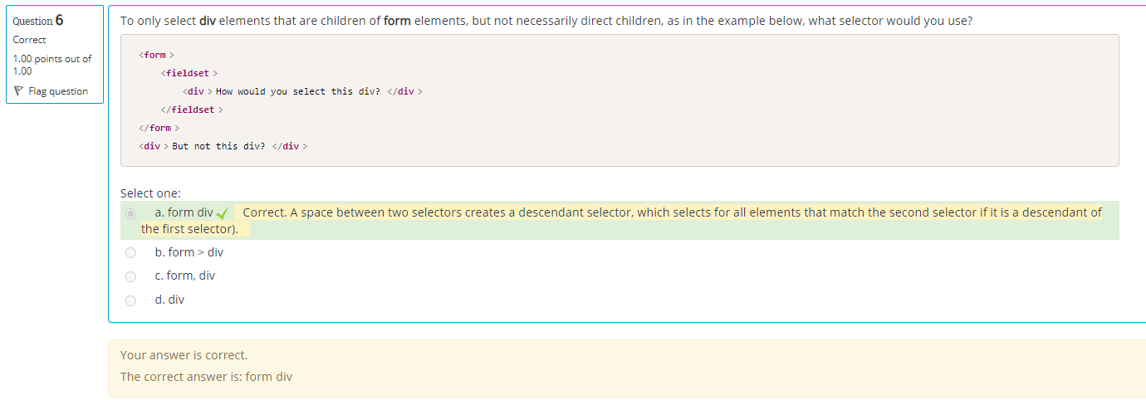
Review: Week 2 Quiz

Slide 35
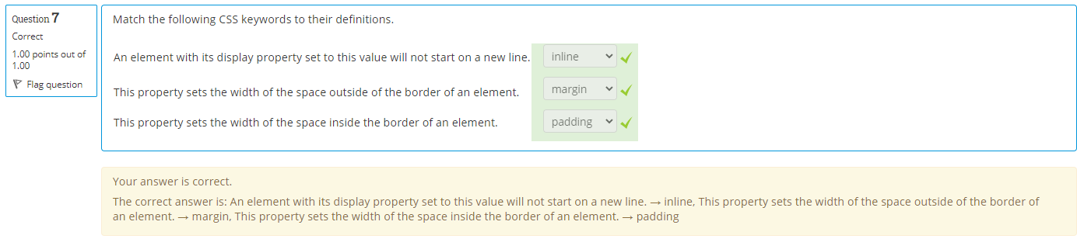
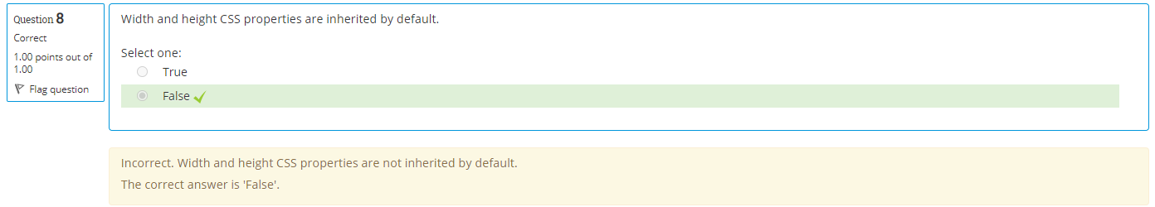
Review: Week 2 Quiz

Slide 36
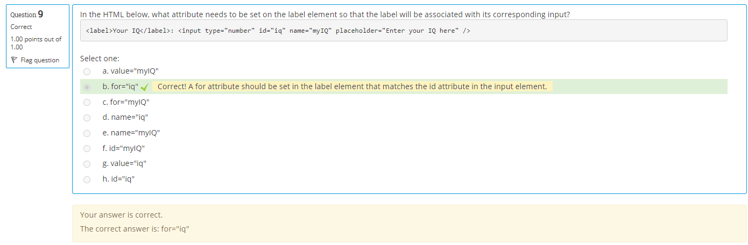
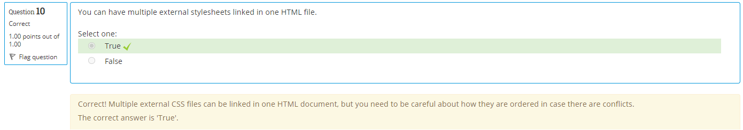
Review: Week 2 Quiz

Slide 37
Happy learning!

